Slide 1
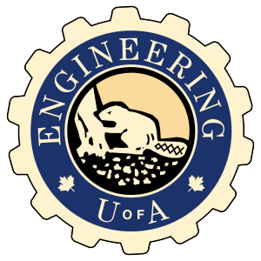

Fundamentals of RM
RM System and Process
Leadership in RM
Incident Investigation
RM Tools & Challenges
RM in Industry
People & Org.
Application and Perspectives
On Becoming a
Leader in Risk Management
ENGG404 - Lecture
Chapter 7.3: Organizational Design and the Relationships Between Leadership, Culture, and Performance

Slide 2
Learning Outcomes:
Differentiate and explain the terms vision, values, guiding principles, mission statement, and policies.
Explain how any organization can be modelled.
Explain the relationship between the culture of the organization and the (safety) performance of organizations.
Chapter 7.3: Organizational Design and Leadership : Culture : Performance
2
Notes:
2

Slide 3
Introduction:
This topic explores :
The four components of an organization and their importance.
The Line Management Model
A Model of Corporate Mechanisms and Supporting Documents
Definitions of Vision, Mission, etc.
The Alignment of the Vision, Mission, Values with the Actual Culture
An Exploration of Organizational Culture
The Model of Corporate Mechanisms, Administrative Controls, Culture, and Results
Chapter 7.3: Organizational Design and Leadership : Culture : Performance
3
Notes:
3

Slide 4
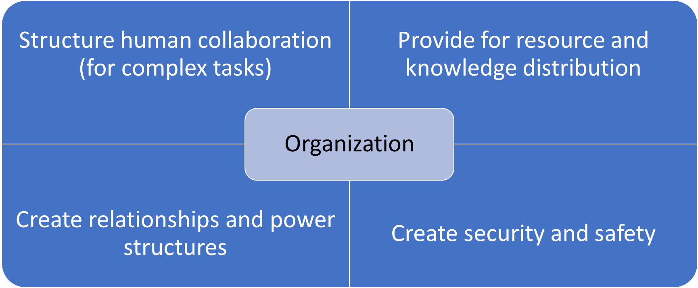
The Four Components of an Organization:
Chapter 7.3: Organizational Design and Leadership : Culture : Performance
4
Notes:
4
Structure: A student project team delivering a project, Assembly line workers in a manufacturing facility
Resource and Knowledge: Reading the assignment, asking questions, sharing input; Parts for each station, training programs, payroll
Relationships and Power: Reinforce teacher-student relationship; Supervisor jobs, people assigned to “good jobs” through seniority
Security and Safety: Group membership, safe work conditions, fair pay

Slide 5
The Importance of The Four Components to You:
You’ll be working soon…by understanding and being able to explain how an organization is structured, you can more readily adapt to it, and as you progress, you can influence it.
The values of an organization influence all four components:
The values translate into the day to day activities of people i.e. the decisions that they make
And that leads to culture: how we do work around here!
The best organizations consider safety and risk management in all four quadrants
Chapter 7.3: Organizational Design and Leadership : Culture : Performance
5
Notes:
5

Slide 6
The Line Management Model:
Every organization is structured like this!
Leaders Exist at All Levels of an Organization
This may be you in the future!
Managers have a large leadership role: they are responsible for those under them, and they influence how their people do work.
Chapter 7.3: Organizational Design and Leadership : Culture : Performance
6
Notes:
6
There is a chain of command in every organization
Line management is responsible and accountable for managing risk of their activities and their operations not the persons in the functional expertise roles
The functional experts are responsible for providing input to all levels of line mgmt. and are often shared amongst different levels of operations

Slide 7
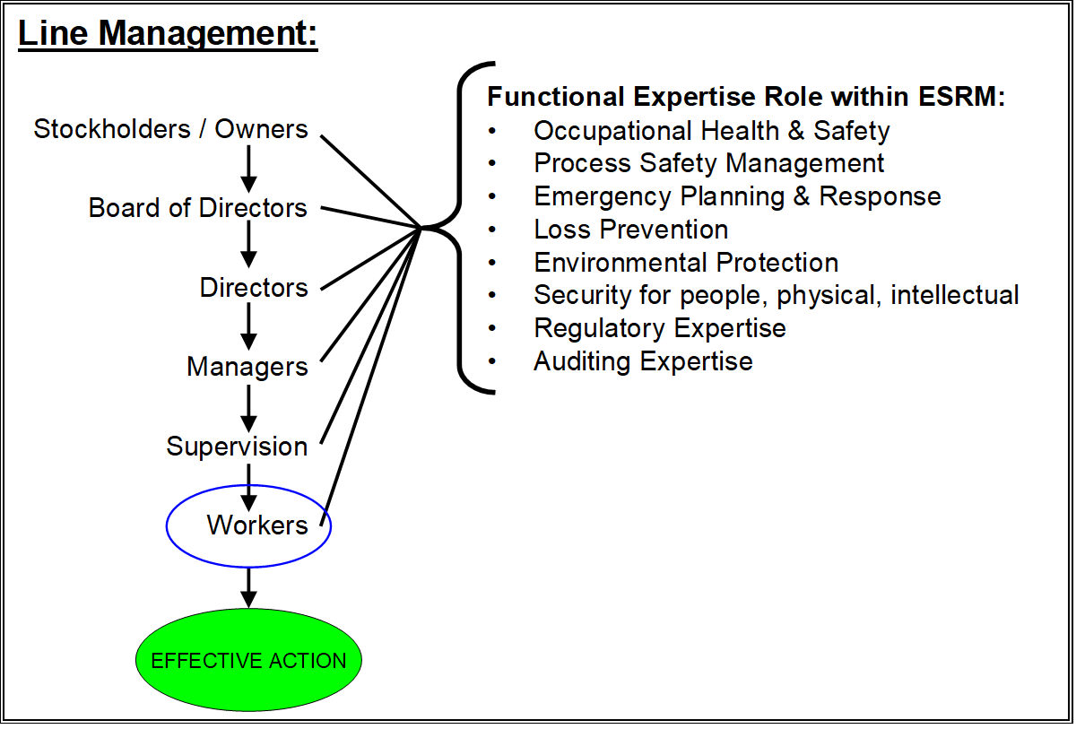
The Line Management Model:
Line Management – The U of A on
the academic organization.
Board of Governors
President
Deans
Associate Deans, Department Chairs & School Directors
Associate Chairs & Associate School Directors
Questions for thought:
Where are you when you start in your career after graduation?
Where do you want to be in 10 years? 20 years?
Professors
Students
Chapter 7.3: Organizational Design and Leadership : Culture : Performance
7
Notes:
7

Slide 8
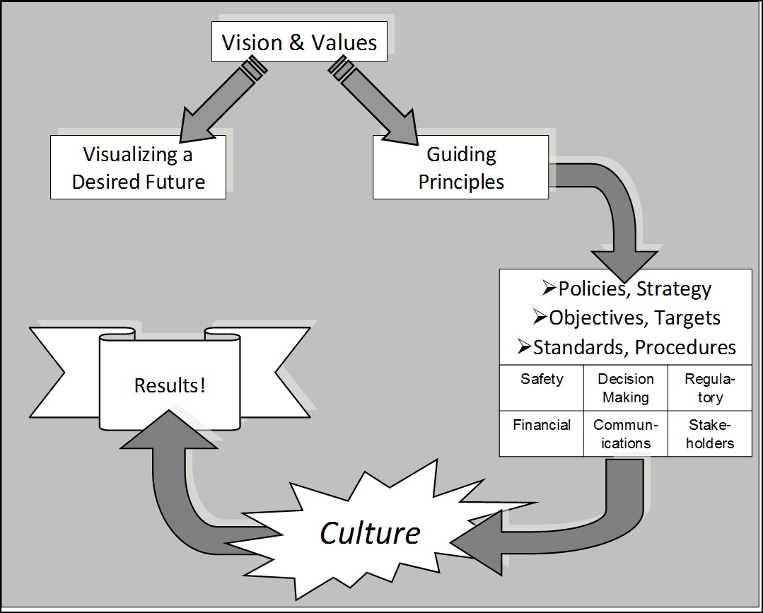
A Model of Corporate Mechanisms & Supporting Documents:
Leading organizations document their aspirations in their “Vision & Values” statements (Vision Statement, Mission Statement, Code of Ethics, Corporate slogans, etc.)
Mission Statement
Chapter 7.3: Organizational Design and Leadership : Culture : Performance
8
Notes:
8

Slide 9
Definitions of Vision, Mission, etc.
Vision: The vision statement captures the desired future state of the organization. “A vision statement says what the organization wishes to be like in some years’ time.” It is “forward thinking”, usually by senior management, on strategic planning and focus on how to achieve that desired future state.
Mission: A “mission statement describes what business the organization is in (and what it isn’t) both now and projecting into the future. Its aim is to provide focus for management and staff” not only on the short-term but also on the longer term. It is congruent with and supports the vision.
Organizational Values: The set of “values describes the desired culture” of the organization i.e. the compass or benchmark on which decisions are based. These are fairly high level.
Organizational Principles: The set of principles “gives employees a set of directions”. These are more descriptive, but not to the point of the details in policies, procedures, and so on.
STRATEGIC PLANNING: Your Company’s Purpose Is Not Its Vision, Mission, or Values; by Graham Kenny; September 03, 2014; HBR; accessed 20-Oct-2020; https://hbr.org/2014/09/your-companys-purpose-is-not-its-vision-mission-or-values
Chapter 7.3: Organizational Design and Leadership : Culture : Performance
9

Slide 10
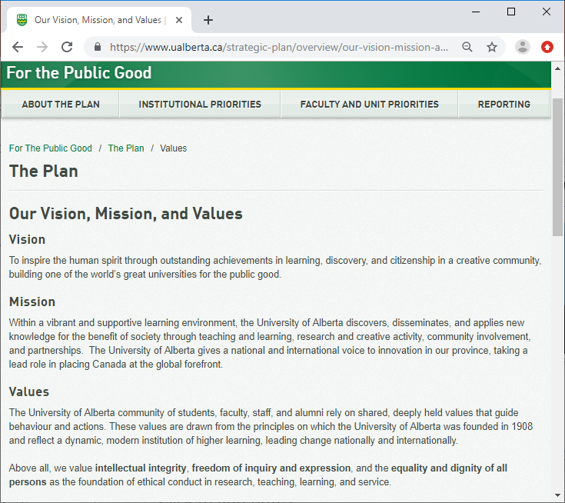
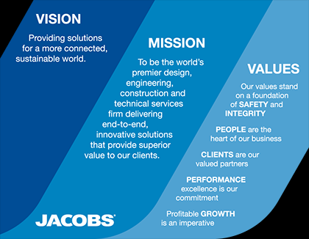
Vision, Mission, Values – Examples:
The University of Alberta:
https://www.ualberta.ca/strategic-plan/overview/our-vision-mission-and-values.html
Jacobs Industrial Services:
http://www.jacobs.com/about#vision-mission-and-values
Chapter 7.3: Organizational Design and Leadership : Culture : Performance
10
Notes:
10

Slide 11
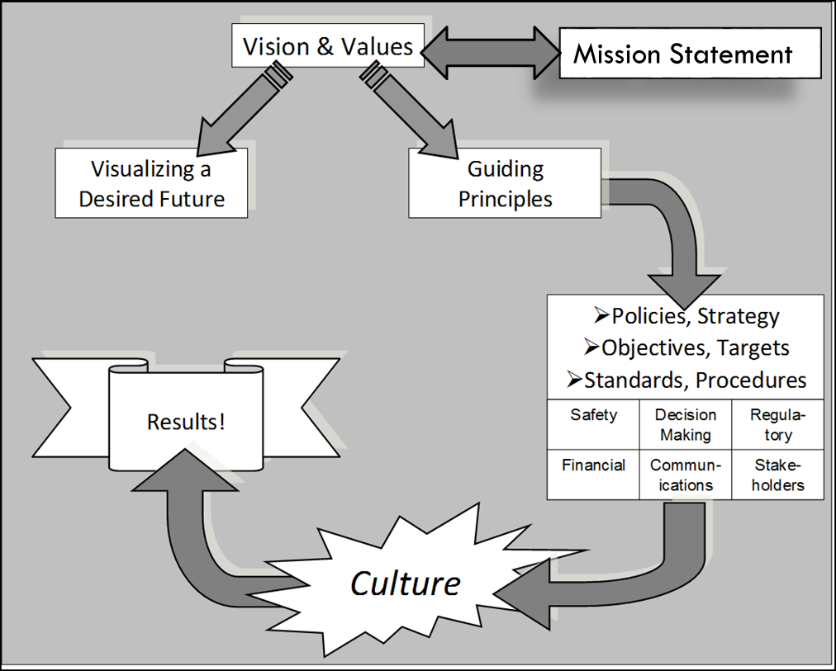
Are Vision, Mission, Values Aligned with the Actual Culture?
Is an Organization “Living” Its Values?
Think back on your work experience. Did those organizations “live” their corporate statements on vision, mission, values, ethics, corporate responsibility, etc.?
Do they live their values or is it just ‘words on the wall’?
Was the culture aligned with their values?
For employees working within
and for leading organizations,
the culture is most definitely,
most of the time, aligned with
the corporate vision, values,
and so on.
?
Chapter 7.3: Organizational Design and Leadership : Culture : Performance
11
Notes:
11

Slide 12

A Further Exploration of Organizational Culture:
Culture, an expressive definition: “The way we do work around here.”
Different performance objectives (vision, etc. leading to the desired results) require different cultures.
The effectiveness of the culture of the organization determines performance of the organization.
Examples:
Bottom-line results
(profitability) … a
for-profit business.
Create a safe and
accepting learning
environment … an
institution of higher
learning.
Stewardship (care for)
of the environment …
an organization
committed to protecting
the environment.
Chapter 7.3: Organizational Design and Leadership : Culture : Performance
12
Notes:
12

Slide 13
We Can Explain This Model in Terms We Already know:
Administrative Controls
Work Practices
“The way we do work around here”
Chapter 7.3: Organizational Design and Leadership : Culture : Performance
13
Notes:
13

Slide 14
The Supporting Administrative Controls:
Administrative Controls:
Aka “standards” i.e. documents such as policies, work processes, procedures, specifications, etc. that establish (set the standard for) and reflect the organization’s culture, and capture their aspirational goals.
Administrative Controls
Chapter 7.3: Organizational Design and Leadership : Culture : Performance
14
Notes:
14

Slide 15
The Work Practices:
Work Practices:
The actual execution of those administrative controls; in other words, “how we do work around here”, and
More truly reflect the culture of the organization.
Administrative Controls
Work Practices
“The way we do work around here”
Chapter 7.3: Organizational Design and Leadership : Culture : Performance
15
Notes:
15

Slide 16
ALE #1: The Model of Corp Mech’s, Adm. Ctrls, Culture, and Results:
Results (the “bottom-line”): In an academic sense, you could equate “the bottom-line” to your grades. Please confer (Open discussion):
Consider these questions:
How are desired results (superior, met or exceeded goals) achieved?
How are less-than-desired results (inferior, did not meet goals) achieved?
Chapter 7.3: Organizational Design and Leadership : Culture : Performance
16
Notes:
16

Slide 17
The Model of Corporate Mechanisms, Administrative Controls, Culture, and Results:
Q: How are results achieved?
A: The organization follows (abides by or complies with) or does not follow the administrative controls in the execution of work i.e. the administrative controls are “brought to life” (or not) by the culture of the organization.
Recall that “culture” is “the
way we do work around here”.
A “good” or “ideal” culture
=> desired results!
Non-ideal culture
=> less-than-desired results.
This is especially true in
risk management!
Chapter 7.3: Organizational Design and Leadership : Culture : Performance
17
Notes:
17

Slide 18
Summary and Key Lessons:
Summary:
Basic constructs of organizations.
Line Management
Vision, Mission, Values, Principles
The administrative controls are “brought to life” by the culture of the organization.
Key Lessons:
There is a relationship between “results” and “culture”:
The vision, mission, values, etc. describe the desired organization and culture in order to achieve the desired results.
The results (the performance) of the organization depends on its culture.
Chapter 7.3: Organizational Design and Leadership : Culture : Performance
18
Notes:
18

Slide 19
Any questions?
Notes:
19

